Slide 1
Hardware Communication with I²C

Slide 2

Introduction
Inter Integrated Circuit
developed 1982 by Philipps Semiconductor (now NXP)
no licensing since 2006
TWI (Two-Wire-Interface) bus is essentially identical
use case:
simplicity
low costs
nowadays maximum transfer rates up to 5 MHz possible, commonly up to 400 kHz

Slide 3
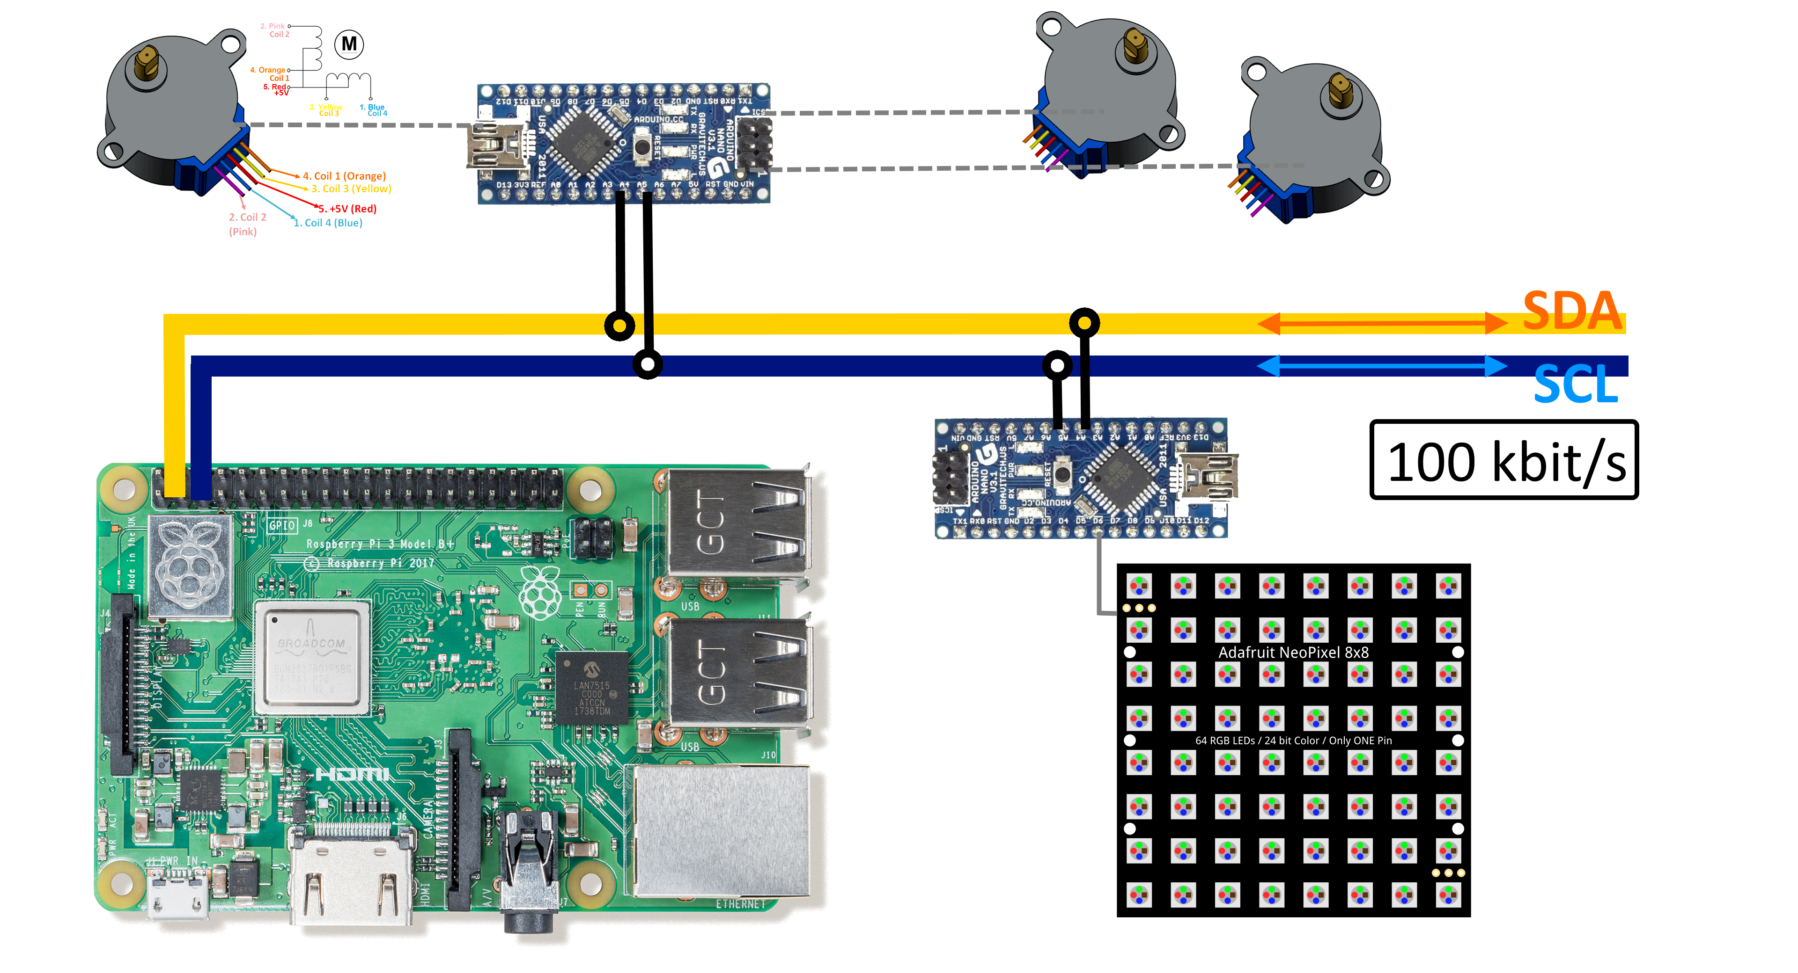
Example Setup
MOTORS
SLAVE
SLAVE
MASTER
LEDARR

Slide 4
Terminology
Term | Description
Master | generates clock (SCL) starts and stops communication sends commands
Slave | device that listens to the bus addressed by the master
Multi-master | more than one master can attempt to control the bus at the same time without corrupting the message
Arbitration | control-procedure on multimaster-systems ensures simultaneous access does not result in loss
Synchronization | clock-stretching
SDA | Serial Data
SCL | Serial Clock

Slide 5
I²C-Properties
synchronous serial communication ⇨ two signals
half-duplex ⇨ alternating bidirectional operation
address-oriented (as opposed to message-oriented)
supports multimaster

Slide 6
I²C-Properties
open-drain system (in contrast to UART and SPI)
bus drivers can only pull SDA to LOW
less conflicts by avoiding contradictory pulls
Pull-up resistors restore both lines always to HIGH

Slide 7
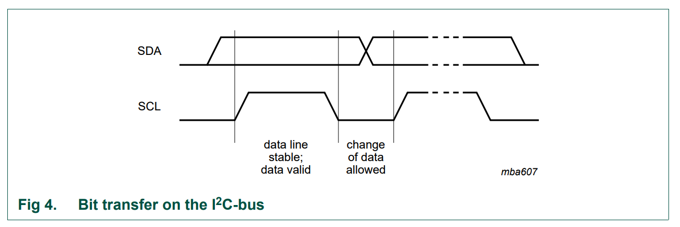
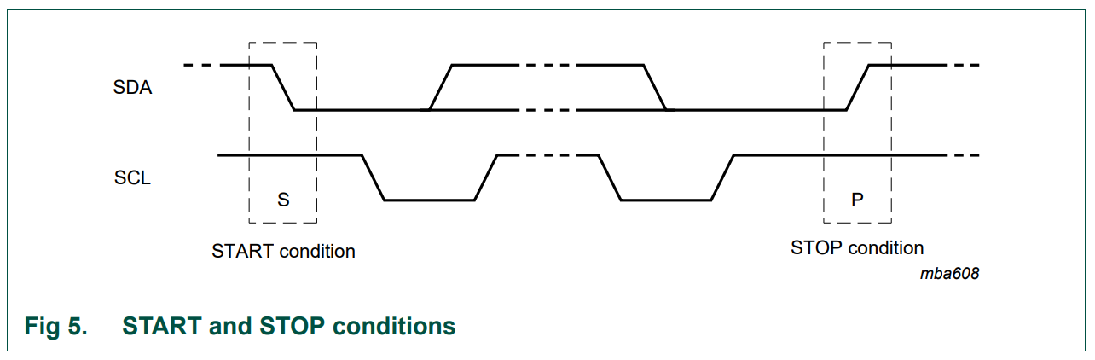
Specification
state of SDA may only change on SCL LOW
SDA has to be stable during HIGH of SCL
one clock pulse for each data bit
START: HIGH-to-LOW on SDA while SCL is HIGH
STOP: Low-to-High on SDA while SCL is HIGH

Slide 8
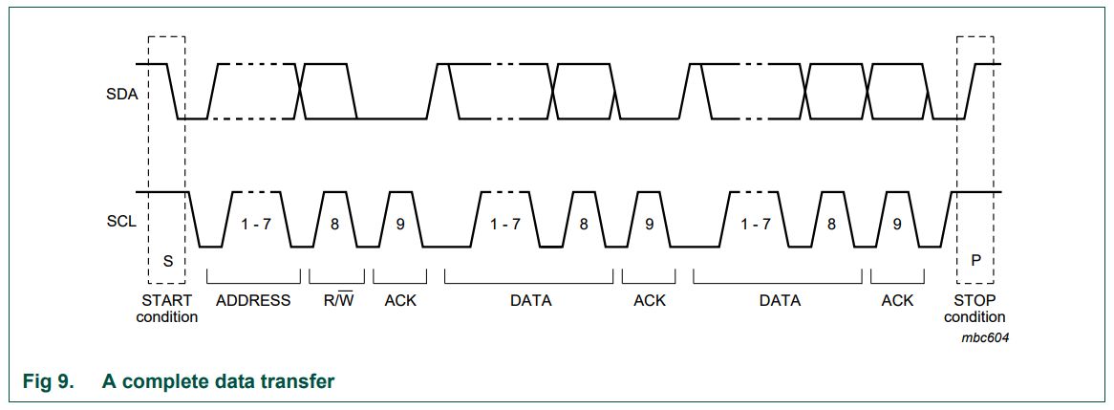
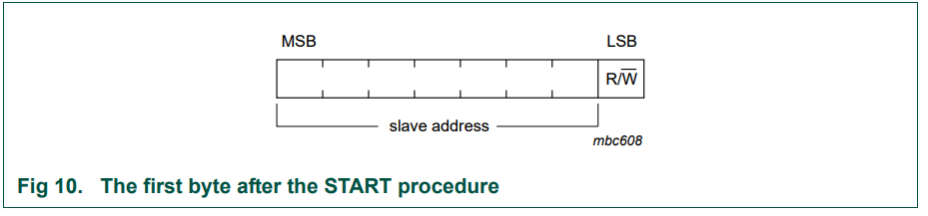
Specification
ACK: Acknowledge
receiving device is given control after first 8 bits
ACK by pulling down SDA
missing ACK terminates transmission
up to Master how to proceed
possible address space is 7 bits
MSB is transmitted first
eighth bit RW indicates data direction
RW: LOW ≙ write, HIGH ≙ read

Slide 9
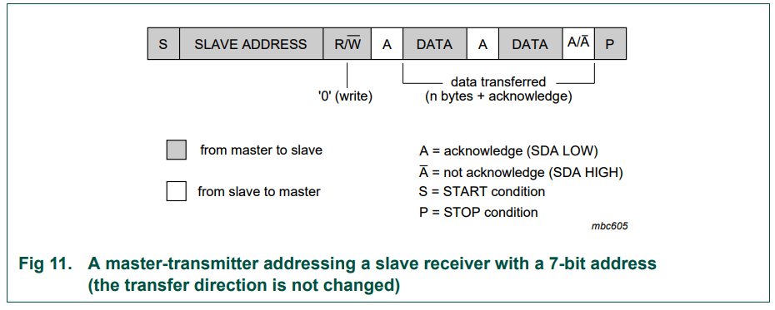
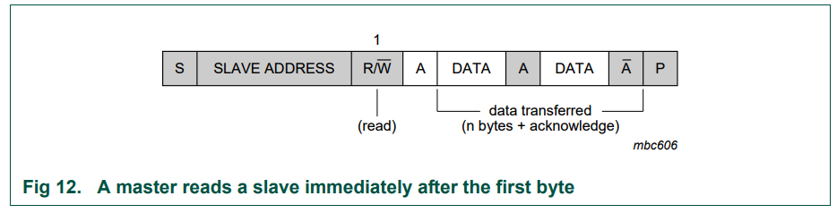
Transfer modes

Slide 10
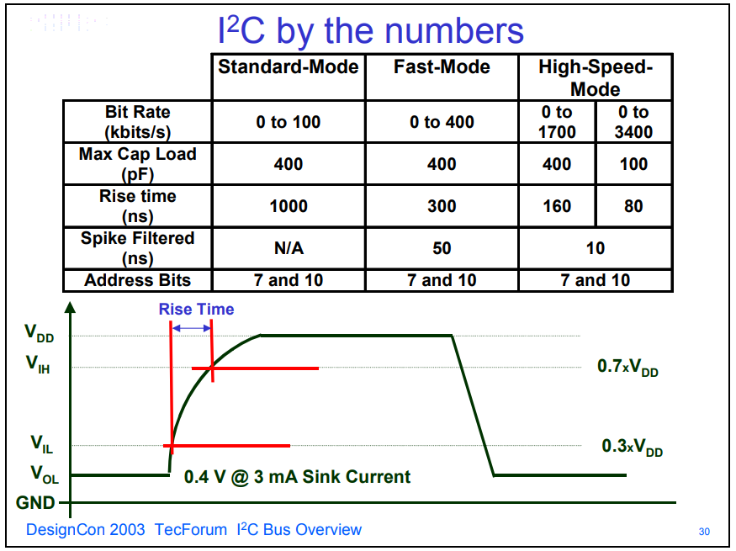
Summary: I²C by the numbers

Slide 11
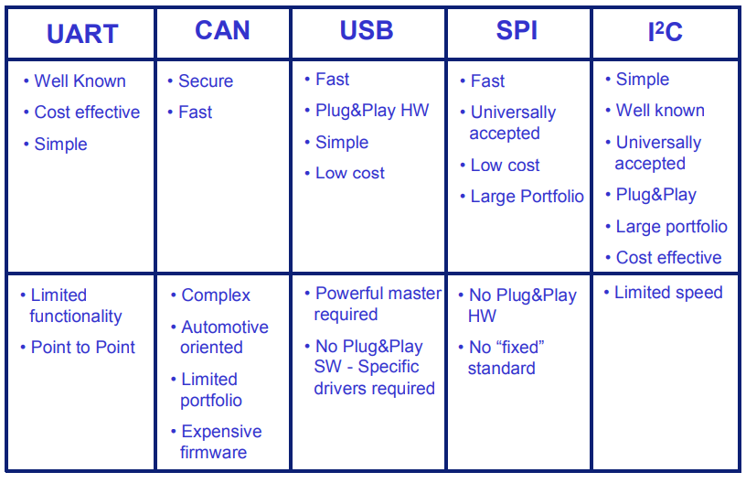
Pros and Cons of the different buses

Slide 12
Sources
Content:
http://ln.iuk.fh-dortmund.de/~gebhard/STA/vortraege/I2C-Bus__Joachim.pdf
https://www.nxp.com/docs/en/user-guide/UM10204.pdf
http://i2c.info/i2c-bus-specification
https://www.i2c-bus.org/i2c-primer/clock-generation-stretching-arbitration/
https://bitwizard.nl/wiki/SPI_versus_I2C_protocols
http://www.w3service.net/vorlesungen/rechnernetze2/0010-protokolldarstellung/Grundbegriffe%20der%20Kommunikation-048.pdf
https://www.nxp.com/docs/en/application-note/AN10216.pdf
Images:
https://www.nxp.com/docs/en/user-guide/UM10204.pdf
https://www.nxp.com/docs/en/application-note/AN10216.pdf
https://www.heise.de/preisvergleich/arduino-nano-3-x-a000005-a799461.html
http://blog.pimoroni.com/introducing-the-raspberry-pi-3-b/
https://www.blinkstick.com/help/tutorials/blinkstick-pro-adafruit-neopixel-matrices
https://components101.com/motors/28byj-48-stepper-motor

Slide 13
Thank you for your attention

